Slide 1

SWIGGY FOOD DELIVERY DATA ANALYSIS
BY CHETAN GOUDAR

Slide 2
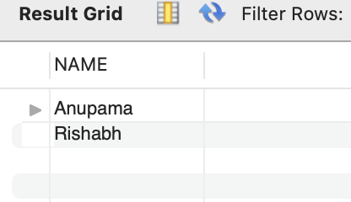
1. How many customers have not placed any orders?
SELECT NAME FROM USERS WHERE
USER_ID NOT IN (SELECT USER_ID FROM ORDERS);
INSIGHTS : Swiggy can identify inactive customers by analyzing those registered but with no order history, offering a key opportunity for re-engagement and targeted marketing.

Slide 3
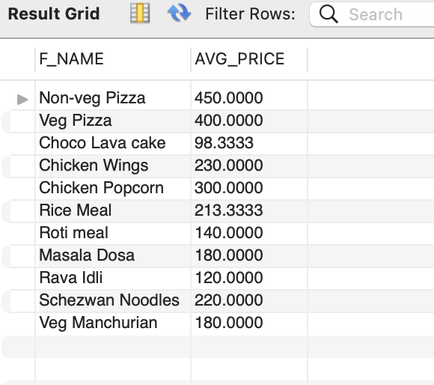
2. What is the average price for each food?
SELECT F.F_NAME, AVG(PRICE) AS AVG_PRICE
FROM MENU M JOIN FOOD F ON M.F_ID=F.F_ID
GROUP BY F.F_NAME;
INSIGHTS : The average price for each food item on Swiggy provides insights into pricing strategies and customer spending patterns, helping optimize menu offerings.

Slide 4
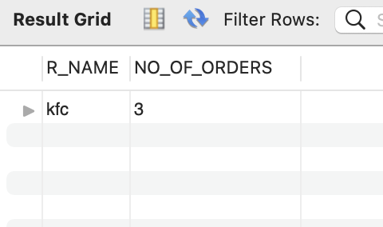
3.Find the top restaurants in terms of number of orders for the month of June?
SELECT R.R_NAME, COUNT(*) FROM ORDERS O JOIN RESTAURANTS R ON O.R_ID = R.R_ID
WHERE MONTHNAME(DATE) = 'JUNE'
GROUP BY R.R_NAME
ORDER BY COUNT(*) DESC
LIMIT 1;
INSIGHTS : The top restaurants in terms of the number of orders for June reveal high-performing outlets, providing insights into customer preferences and successful restaurant offerings on Swiggy's platform.

Slide 5
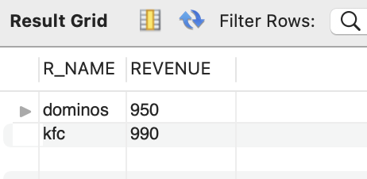
4. Find the restaurants with monthly revenue greater than 500?
SELECT R.R_NAME, SUM(AMOUNT) AS REVENUE FROM ORDERS O JOIN RESTAURANTS R ON O.R_ID = R.R_ID
WHERE MONTHNAME(DATE) = 'JUNE'
GROUP BY R.R_NAME
HAVING REVENUE > 500;
INSIGHTS : Restaurants with monthly revenue greater than 500 on Swiggy showcase consistent demand and high customer engagement, indicating their strong market position and popular menu offerings.

Slide 6
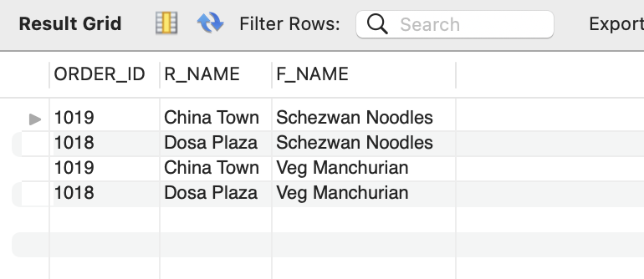
5.Show all orders with order details for a particular customer in a particular date range (10th June 2022 to 10th July 2022)?
SELECT O.ORDER_ID, R.R_NAME, F.F_NAME FROM ORDERS O
JOIN RESTAURANTS R ON R.R_ID = O.R_ID
JOIN ORDER_DETAILS OD
ON O.ORDER_ID = OD.ORDER_ID
JOIN FOOD F ON F.F_ID = OD.F_ID
WHERE USER_ID =
(SELECT USER_ID FROM USERS WHERE NAME LIKE 'ANKIT') AND
DATE BETWEEN '2022-06-10' AND '2022-07-10’;
INSIGHTS : All orders for a particular customer between 10th June 2022 and 10th July 2022 on Swiggy provide insights into their food preferences, ordering patterns, and frequency within the given timeframe, which can be useful for personalized marketing or loyalty programs.

Slide 7
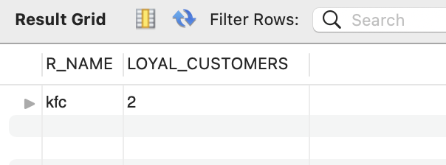
6.Find the restaurants with the maximum repeated customers?
SELECT R.R_NAME, COUNT(*) AS LOYAL_CUSTOMERS
FROM (
SELECT R_ID, USER_ID, COUNT(*) AS VISITS
FROM ORDERS
GROUP BY R_ID,USER_ID
HAVING VISITS > 1 ) T
JOIN RESTAURANTS R ON R.R_ID = T.R_ID
GROUP BY R.R_NAME
ORDER BY LOYAL_CUSTOMERS DESC
LIMIT 1;
INSIGHTS : Restaurants with the maximum repeated customers on Swiggy are likely delivering exceptional service, food quality, and customer satisfaction, making them ideal candidates for partnerships, promotions, and loyalty programs.

Slide 8
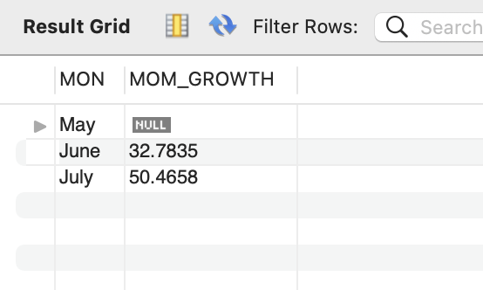
7. Find the month over month revenue growth of swiggy?
SELECT MON, ((REVENUE - PREV )/PREV)*100 AS MOM_GROWTH
FROM (
WITH SALES AS(
SELECT MONTH(DATE), MONTHNAME(DATE) AS MON ,
SUM(AMOUNT) AS REVENUE FROM ORDERS
GROUP BY MONTH(DATE),
MONTHNAME(DATE)
ORDER BY MONTH(DATE)
)
SELECT MON, REVENUE,
LAG(REVENUE,1) OVER(ORDER BY REVENUE) AS PREV FROM SALES
) T;
INSIGHTS: The month-over-month revenue growth of Swiggy shows the platform’s ability to increase its revenue by expanding its customer base, improving order frequency, and boosting customer retention. A positive trend indicates business scalability, while any drop may reveal challenges in customer engagement or competitive pressures.

Slide 9
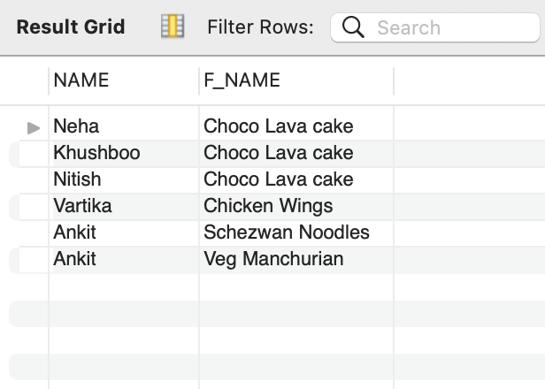
8. Find the favorite food for each customer?
WITH TEMP AS(
SELECT O.USER_ID, OD.F_ID, COUNT(*) AS FREQUENCY FROM ORDERS O
JOIN ORDER_DETAILS OD ON O.ORDER_ID = OD.ORDER_ID
GROUP BY O.USER_ID,OD.F_ID
)
SELECT U.NAME, F.F_NAME FROM TEMP T1
JOIN USERS U ON U.USER_ID = T1.USER_ID
JOIN FOOD F ON F.F_ID = T1.F_ID
WHERE T1.FREQUENCY =
(SELECT MAX(FREQUENCY) FROM TEMP T2
WHERE T2.USER_ID = T1.USER_ID);
INSIGHTS: The favorite food for each customer can be determined by identifying the most frequently ordered dish by each individual. This insight can help Swiggy enhance customer personalization, tailor recommendations, and run targeted promotions based on popular choices, ultimately improving customer satisfaction and retention.

Slide 10
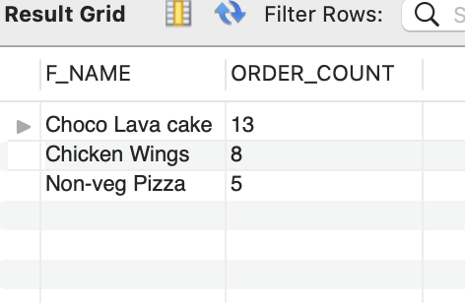
9. Find the top 3 most ordered dish?
SELECT F_NAME,ORDER_COUNT FROM (
SELECT F_NAME,COUNT(*) as ORDER_COUNT, ROW_NUMBER()
OVER(ORDER BY COUNT(*) DESC) AS ROWNUM FROM ORDER_DETAILS OD
INNER JOIN FOOD F
ON F.F_ID = OD.F_ID
GROUP BY F_NAME
ORDER BY ORDER_COUNT DESC
) T
WHERE ROWNUM <= 3;
INSIGHTS : The top 3 most ordered dishes can be identified by analyzing the frequency of orders for each dish. These insights can help Swiggy in optimizing inventory, featuring popular dishes on their platform, and collaborating with restaurants to ensure availability, thereby improving customer satisfaction and boosting sales.

Slide 11
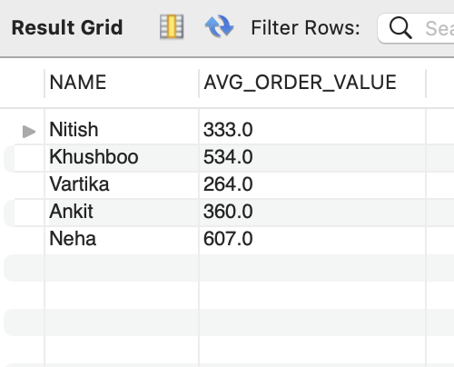
10. What is the average order value per user?
SELECT NAME, ROUND(AVG(AMOUNT),1) AS AVG_ORDER_VALUE
FROM ORDERS O JOIN USERS U
ON O.USER_ID = U.USER_ID
GROUP BY NAME;
INSIGHTS : The average order value per user indicates the typical spending behavior on Swiggy. This insight helps in assessing customer purchasing power, tailoring promotions, and setting pricing strategies. A higher average order value may suggest a willingness to spend more on premium options, while a lower value could highlight opportunities to upsell or offer value deals.

Slide 12
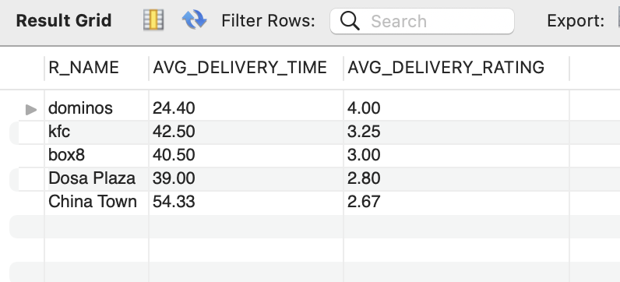
11. What is the average delivery time for each restaurant, and how does it affect customer satisfaction?
SELECT R.R_NAME, ROUND(AVG(O.DELIVERY_TIME),2) AS AVG_DELIVERY_TIME, ROUND(AVG(O.DELIVERY_RATING),2) AS AVG_DELIVERY_RATING
FROM ORDERS O
JOIN RESTAURANTS R ON O.R_ID = R.R_ID
GROUP BY R.R_NAME;
INSIGHTS : The average delivery time for each restaurant provides insight into operational efficiency and customer experience. Shorter delivery times generally enhance customer satisfaction, leading to better reviews and repeat business. Restaurants with longer delivery times may need to improve their logistics or communicate more effectively with customers about estimated delivery windows to mitigate dissatisfaction.

Slide 13
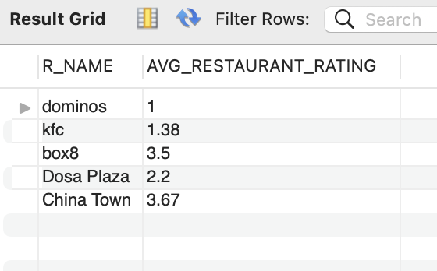
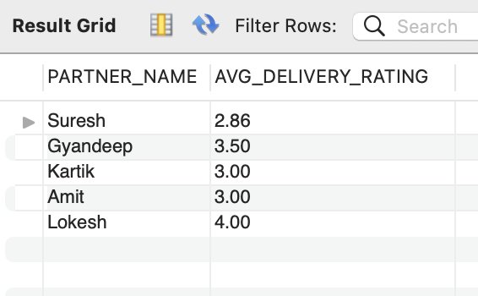
12. What is the average rating for each restaurant and delivery partner?
SELECT R.R_NAME, ROUND(AVG(O.RESTAURANT_RATING),2) AS AVG_RESTAURANT_RATING
FROM ORDERS O
JOIN RESTAURANTS R ON O.R_ID = R.R_ID
GROUP BY R.R_NAME;
SELECT DP.PARTNER_NAME,
ROUND(AVG(O.DELIVERY_RATING),2) AS AVG_DELIVERY_RATING
FROM ORDERS O
JOIN DELIVERY_PARTNER DP ON O.PARTNER_ID = DP.PARTNER_ID
GROUP BY DP.PARTNER_NAME;
INSIGHTS: The average rating for each restaurant and delivery partner reflects overall customer satisfaction and service quality. High ratings for restaurants indicate popular menu items and positive dining experiences, while high ratings for delivery partners suggest reliable and efficient service. Conversely, low ratings may highlight areas needing improvement, such as food quality, delivery timeliness, or customer service.

Slide 14
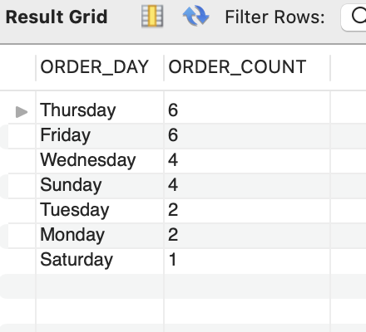
13. Which days see the highest order volume, and are there any patterns in user behavior?
SELECT DAYNAME(DATE) AS ORDER_DAY,
COUNT(ORDER_ID) AS ORDER_COUNT
FROM ORDERS
GROUP BY DAYNAME(DATE)
ORDER BY ORDER_COUNT DESC;
INSIGHTS : The days with the highest order volumes typically occur during Thursday and Friday. Analyzing user behavior patterns reveals that users often place orders during these peak days, indicating a preference for convenience during busy times. Additionally, promotions or discounts might drive higher order volumes on specific days or times, such as special offers on weekends. Identifying these patterns can help optimize marketing strategies and improve service availability.

Slide 15
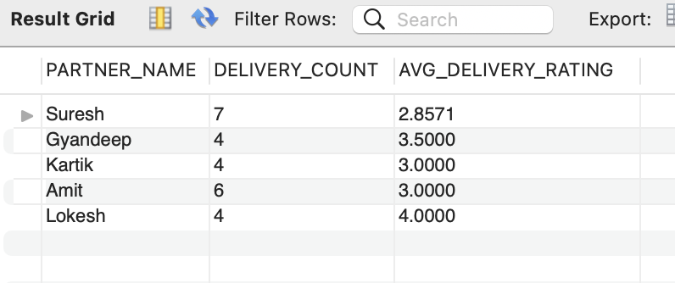
14. How many orders were delivered by each delivery partner and what is their average delivery rating?
SELECT DP.PARTNER_ID, DP.PARTNER_NAME, COUNT(*) AS DELIVERY_COUNT, AVG(O.DELIVERY_RATING) AS AVG_DELIVERY_RATING
FROM ORDERS O
JOIN DELIVERY_PARTNER DP
ON O.PARTNER_ID = DP.PARTNER_ID
GROUP BY DP.PARTNER_ID, DP.PARTNER_NAME;
INSIGHTS : Analyze the total number of orders delivered by each delivery partner and calculate their average delivery rating to assess performance and customer satisfaction.

